Slide 1
Plate Tectonics
Table of Contents
Drifting Continents
Sea-Floor Spreading
The Theory of Plate Tectonics

Slide 2
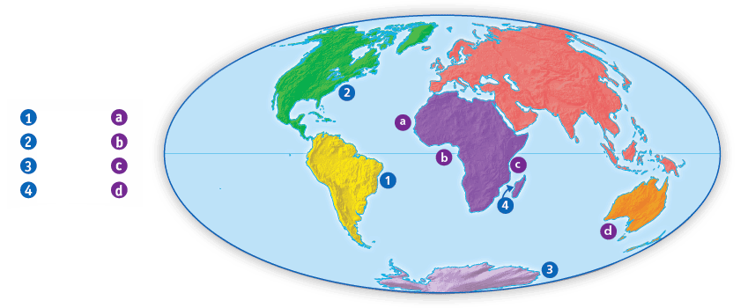
Drifting Continents
Piecing It All Together
The coastlines of some continents seem to fit
together like a jigsaw puzzle.

Slide 3
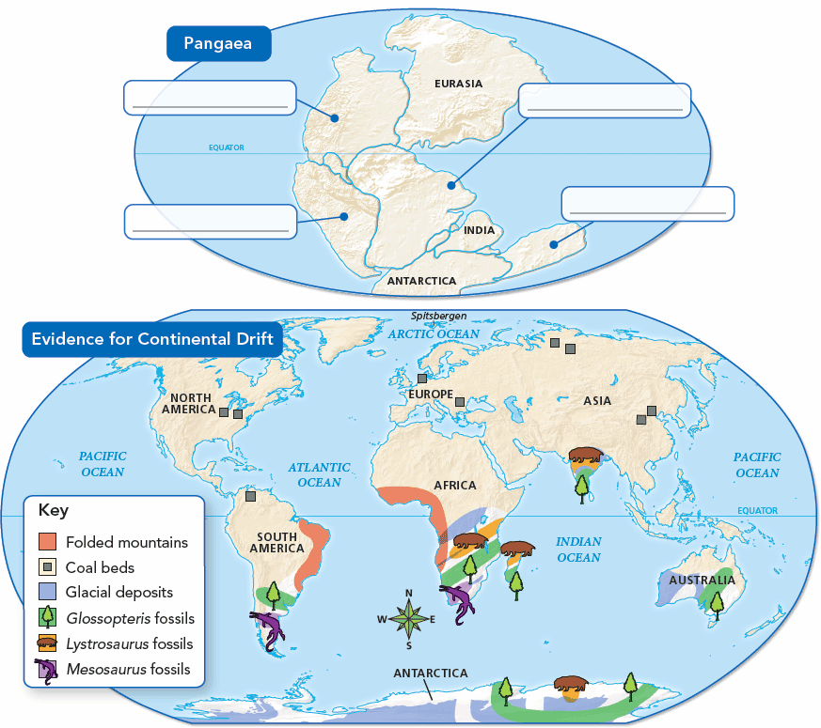
Drifting Continents
Pangaea and Continental Drift
Many types of evidence suggest that Earth’s landmasses were once joined together.

Slide 4
What are Mid-Ocean Ridges
Scientists found that they formed mountain ranges that run along the middle of the ocean floors
Scientists call these mid-ocean ridges
**They form long chains of mountains that rise up from the ocean floor
They extend into all of Earth’s oceans
Some form the longest mountain ranges on Earth
Some are longer that the Rockies in North America and longer that the Andes in South America

Slide 5
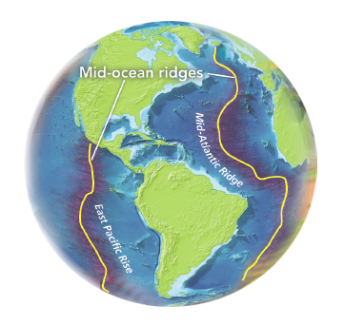
Sea-Floor Spreading
Ocean Floors
Mid-ocean ridges rise from the sea floor like stitches on the seams of a baseball.

Slide 6
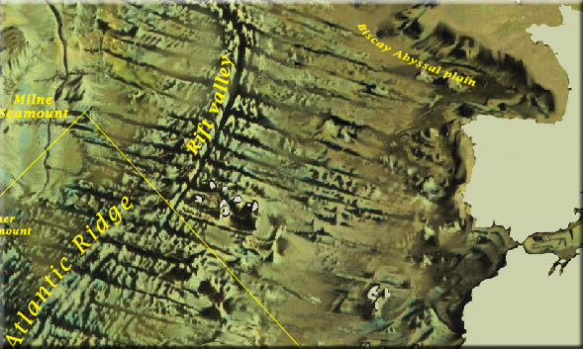
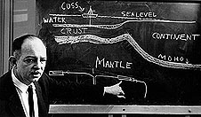
The Hypothesis of Sea-Floor Spreading
The Great Global Rift
Who proposed this hypothesis?
In 1960, Herman Hess proposed that the movement of the continents was a result of sea-floor spreading. He hypothesized that the sea-floor was spreading from vents in the Great Global Rift, where hot magma oozed up. As the magma cooled it forced the existing sea-floor away from the Rift on either side.

Slide 7
How were mid-oceans ridges found
In the mid 1900’s scientists mapped mid-oceans ridges by using sonar.
Sonar- is a device that uses sound waves to measure the distant of an object.
Scientists also discovered that a steep sided valley splits the tops of some mid-ocean ridges

Slide 8
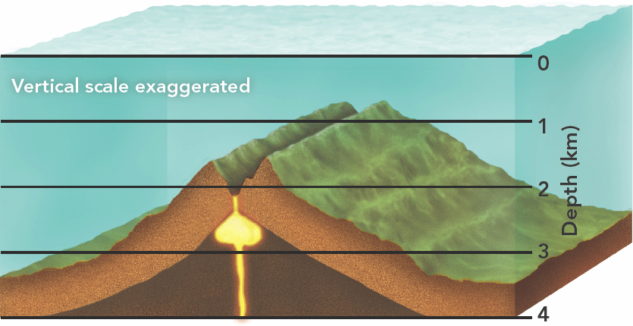
Sea-Floor Spreading
Mid-Ocean Ridges

Slide 9
What is Sea-Floor Spreading
Sea-Floor Spreading -Scientists found that mid-ocean ridges continue to add new material to the ocean floor
Sea-Floor Spreading begins at the mid-ocean ridge
They are formed along the crack of the oceanic crust.
New molten material rise up from inside Earth
It erupts, then cools down and hardens to form a solid strip of rock.

Slide 10
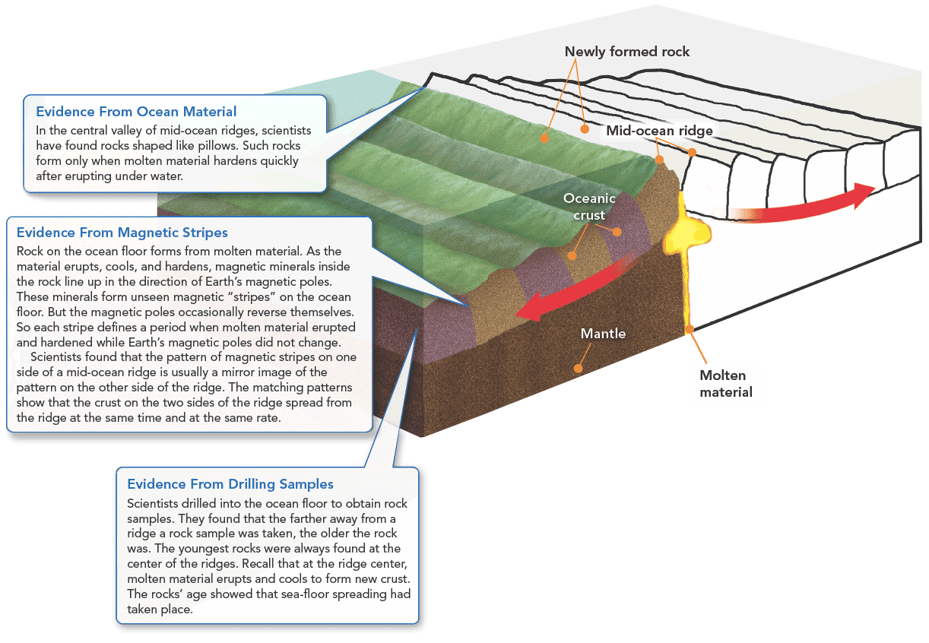
**Sea-Floor Spreading adds more crust to the ocean floor. At the same older strips of rock move outward from either side of the ridge- pg 337
Sea-Floor Spreading
Some mid-ocean ridges have a valley that runs along their center. Evidence shows that molten material erupts through this valley and then hardens to form the ocean floor.

Slide 11
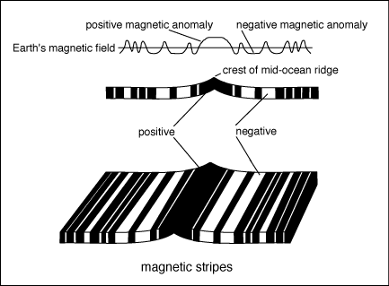
Sea Floor Spreading at Mid-Ocean Ridges
3. Magnetic striping has been observed.
The Earth’s magnetic field reverses itself
Every few thousand years.

Slide 12
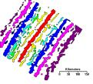
Sea Floor Spreading at Mid-Ocean Ridges
Magnetic reversals have been recorded
on the ocean floor.

Slide 13
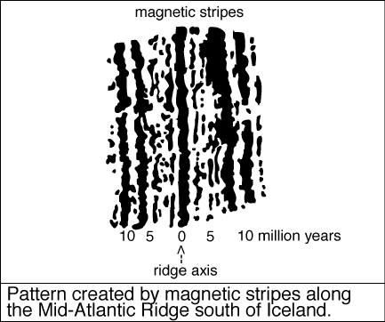
What Was The Proof Of Sea-Floor Spreading?
1. Ancient magnetism records flip-flops of
earth’s magnetic field.

Slide 14
What Happens at Deep-Ocean Trenches
The Ocean floor do not keep on getting wider without stopping
Deep-ocean trenches- Deep underwater canyons where the ocean floor eventually plunges into.
**In a process taking tens of millions of years, part of the ocean floor sinks back into the mantle at deep-ocean trenches

Slide 15
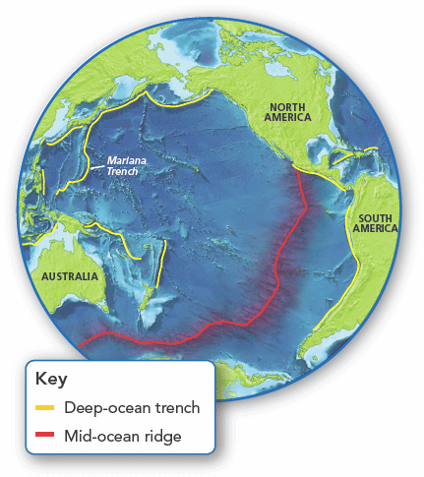
Sea-Floor Spreading
Deep-Ocean Trenches
The deepest part of
the ocean is along the Mariana Trench. Several trenches in the Pacific Ocean are shown in yellow.

Slide 16
The Process of Subduction
Remember the higher the density the object will sink
Changes in density affect the ocean floor in the same way
The subduction process:
1-new oceanic crust is hot, but as it moves away from the mid-ocean ridge it cools down and becomes more dense
2- the cool dense crust might collide with the edge of a continent
3-gravity then pulls the older, denser oceanic crust back down under the trench and back into the mantle

Slide 17
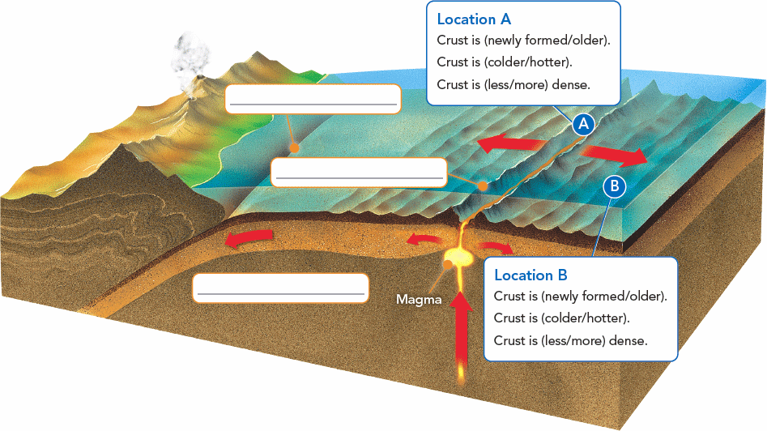
Sea-Floor Spreading
Subduction: The process by which the ocean floor sink beneath a deep-ocean trench and back into the mantle again
Subduction Process
Oceanic crust created along a mid-ocean ridge is
destroyed at a deep-ocean trench.
During the process of subduction, oceanic crust sinks down beneath the trench into the mantle.

Slide 18
Subduction and Earth’s Oceans
Subduction and sea-floor spreading can change the size and shape of the oceans.
The ocean floor is renewed about every 200 million years
Oceans surrounded by many trenches may shrink, while oceans with few trenches will probably grow
Example: the Atlantic ocean is expanding

Slide 19
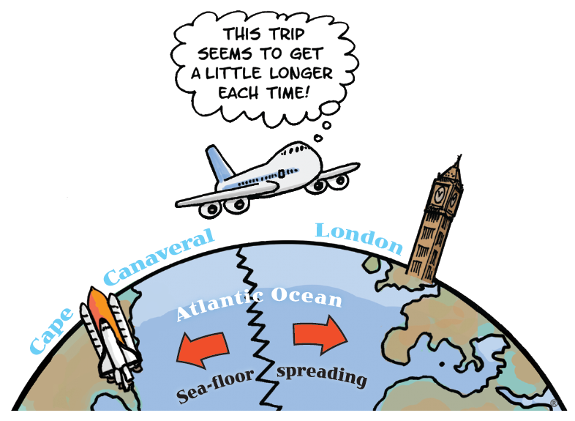
The Theory of Plate Tectonics
Slip-Sliding Away
In 30 million years, this airplane might take one hour longer to fly from Florida to London than it takes today. That’s because Florida and Europe are riding on two different pieces of Earth’s crust that are moving slowly away from each other!

Slide 20
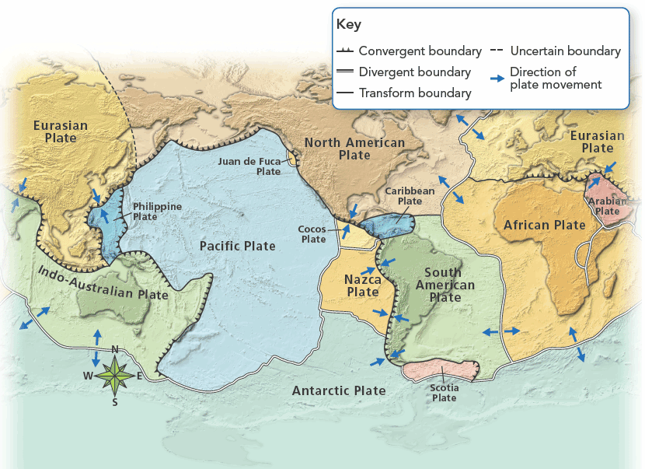
The Theory of Plate Tectonics
Earth’s Plates
Plate boundaries divide the lithosphere into large plates.

Slide 21
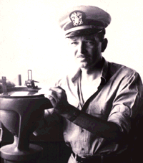
What happened?
Hess' ideas neatly explained why the Earth does not get bigger with sea floor spreading and why oceanic rocks are much younger than continental rocks.
Hess died in 1969. Unlike Wegener, he was able to see his seafloor-spreading hypothesis largely supported as knowledge of the ocean floor increased dramatically during his lifetime.

Slide 22
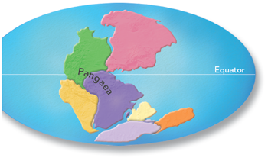
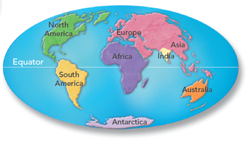
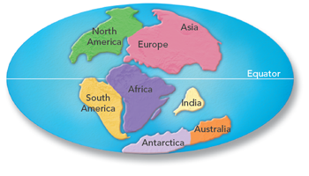
The Theory of Plate Tectonics
Plate Motion
Since the breakup of Pangaea, the continents have taken about 200 million years to move to their present location.
200 Million Years Ago
Earth Today
115 Million Years Ago

Slide 23
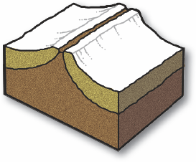
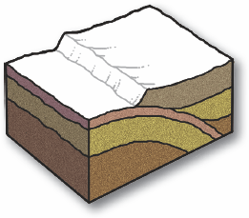
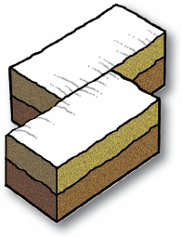
The Theory of Plate Tectonics
How do the plates move?
Divergent
Boundaries
Convergent
Boundaries
Transform
Boundaries

Slide 24
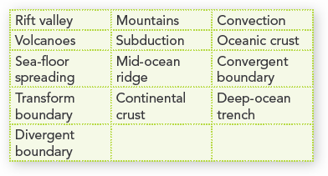
The Theory of Plate Tectonics
Earth's Changing Crust
As plates move, they produce mountains, volcanoes, and valleys as well as mid-ocean ridges and deep-ocean trenches. Use the terms from the list to label the diagram.

